Slide 1
Working Remotely
with Microsoft Teams
Presented by: Meagan Lai & Yufei Du

Slide 2
Getting Started
Log into Teams using your uWaterloo credentials either through:
teams.microsoft.com
Your desktop application
You can download the desktop application by logging on online

Slide 3
AGENDA
What is Microsoft Teams?
What can Teams do?
How do I create a Team?
Where can I get help for Teams?
Getting started with Teams
Useful resources

Slide 4
WHAT IS TEAMS?
One application that brings together all programs in Office 365
Group and individual conversations
Provides a shared space to work on and store files collaboratively
Can collaborate with UWaterloo and non-UWaterloo members

Slide 5
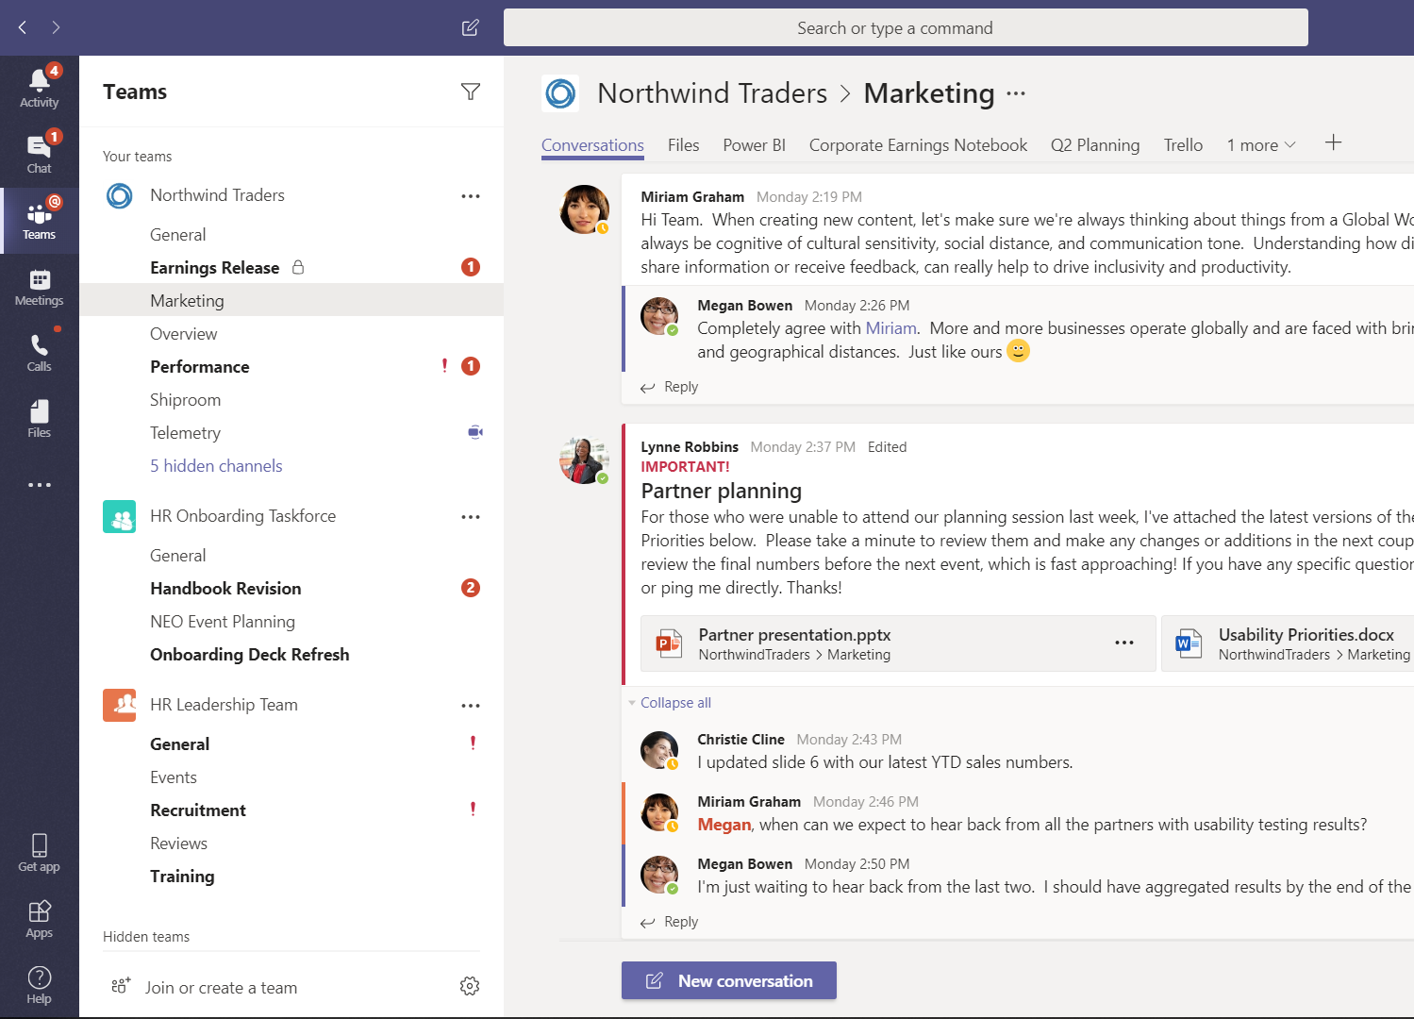
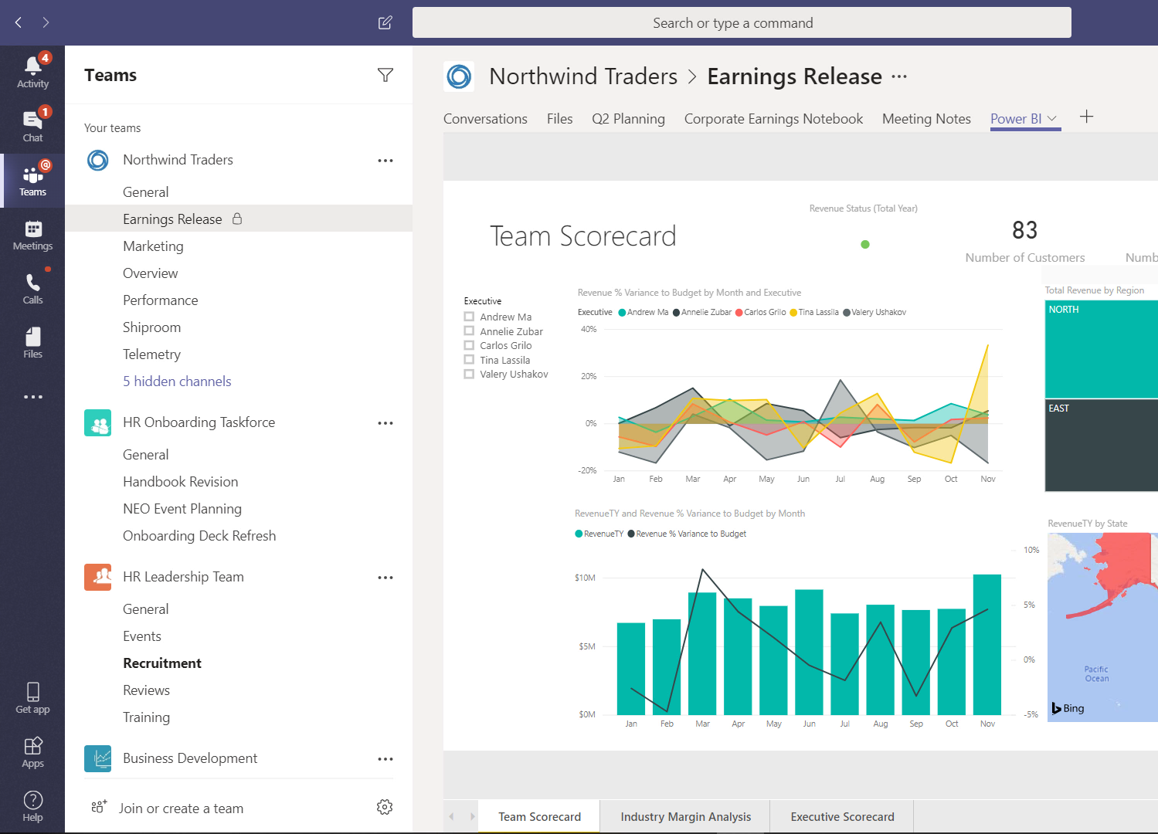
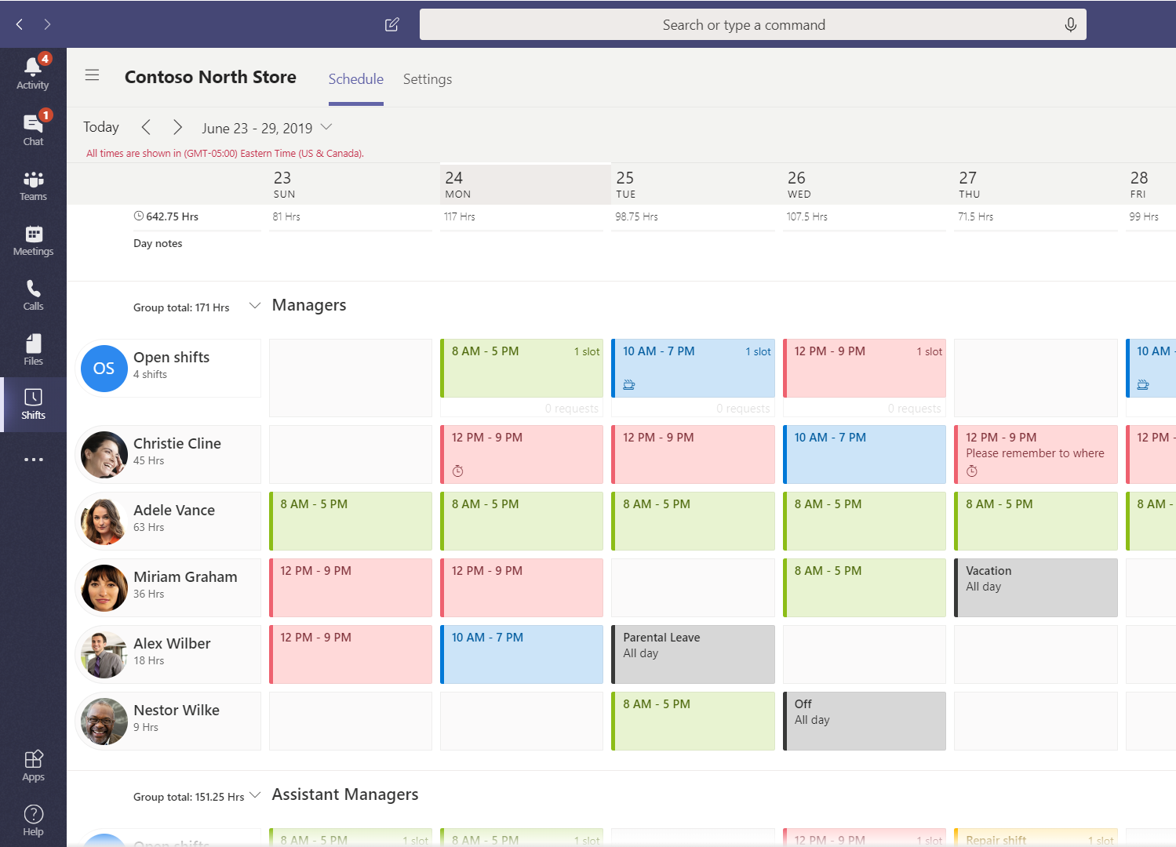
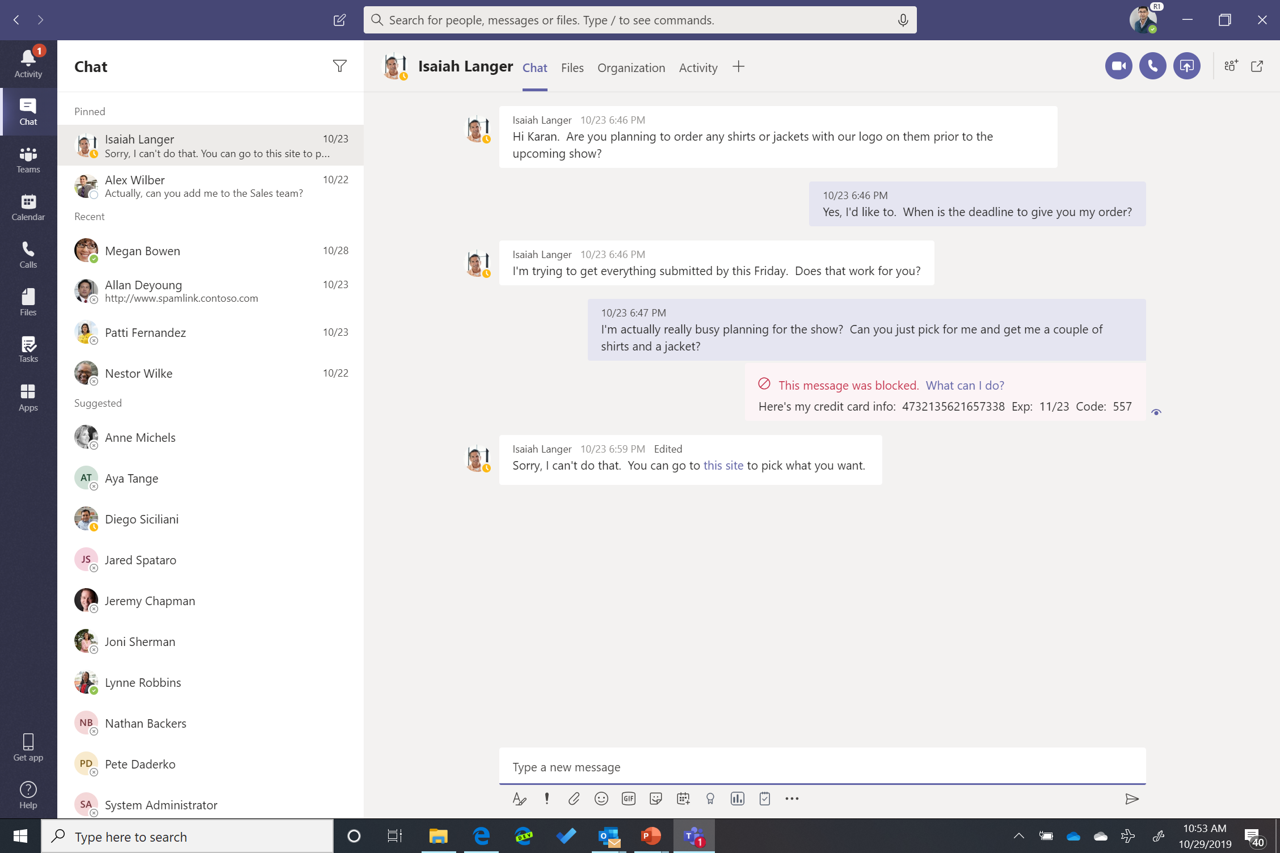
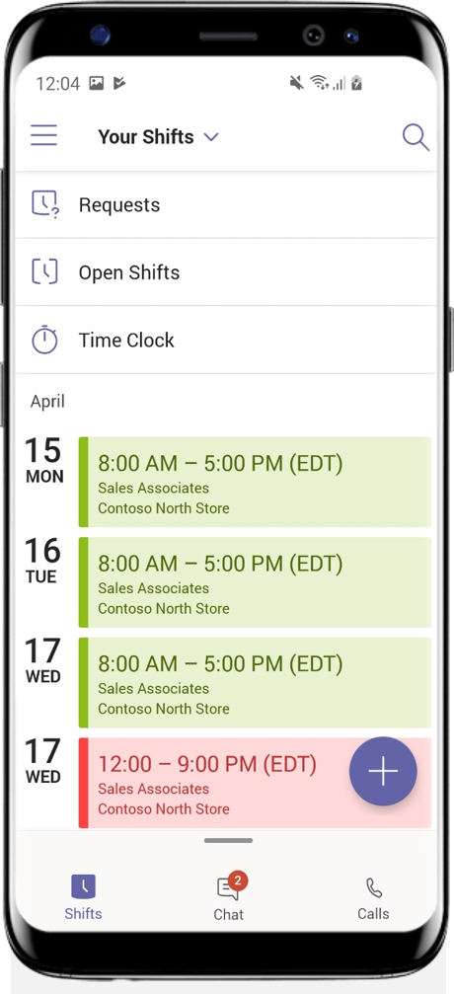
Transform workplace collaboration
Streamline business processes
Connect everyone on
a single platform
Provide enterprise grade security & compliance

Slide 6
Before THE MEETING
Chat with attendees
Collaborate on documents and presentations
Review history and context to prepare for the meeting
DURING THE MEETING
Co-author Office 365 documents
Follow along with live captions and subtitles, regardless of the language spoken
Contribute and share in real-time with digital ink and the integrated Microsoft Whiteboard
Participate from anywhere like you are in the room
AFTER THE MEETING
Review meeting notes and track assigned follow-ups
Access meeting recordings and transcripts, and search for keywords, names and topics
Continue to chat and collaborate on documents, whiteboards, and action items
Schedule and manage ongoing meetings and tasks with the team

Slide 7
Microsoft Teams is evolving
Ignite 2018
Ignite 2019
Live Events usage reports
Microsoft Teams Rooms
Location sharing
New and existing teams can now accommodate up to 5,000 members
Microsoft Whiteboard in Teams meetings (commercial preview)
Meetings First (in preview)
Media Bypass
Cloud Voicemail support for Skype for Business Server and Lync Server 2013
Proximity-based meeting join
Calls App for VOIP users
Call me functionality in meetings
100 people in a Group Chat
Single toolbar option in meetings and calling
Video support in Chrome meetings
Teams for education weekly email updates for parents
@-less mentions
Channel notification control
Meet Now
“missed-meeting add” notifications
Shifts
Teams available for US GCC High
Request to add others to private teams
Multi-team support for Shifts
Focus time in Teams
Microsoft Graph APIs—Installing apps to teams using application permissions (preview)
Microsoft Graph APIs—New ways to send messages in channel, email, and bots (preview)
Microsoft Graph APIs—Create teams with a single API call (preview)
Control for Microsoft Teams by Smarsh
InformCast Fusion from Singlewire Software
Export Teams usage reports to CSV files
Azure pipelines for Teams to help you automate
Teams-Only Mode
Custodian management for Teams memberships (preview)
Supervision for Teams channels and chats
App setup policies
Discovery management of private teams
Microsoft Graph APIs—Create teams with Team Templates (including education, retail, and healthcare)
Microsoft Graph APIs—Configure five new types of tabs—Word, Excel, PowerPoint, PDF, and document libraries
New Meeting Devices, Phones, and Peripherals—learn more at Microsoft Teams Marketplace
New GitHub iterations-Messaging extension, Bot, and personal app capabilities
Data loss prevention for chat messages and channel conversations
Read-only Class Materials folder for Teams for Education
Microsoft Graph APIs - Deep links to channels (preview)
Virtualized SBCs (available now from partners)
“Meeting started” phone notifications
Teams for education gradebook
Lightweight meeting join for IE, Safari, and Firefox
MVISION for Microsoft Teams by McAfee
Retention for Teams Channels and chats
Unified Presence in US GCC
Busy on Busy signal
Meeting options for lobby control
Interop in Of365 for GCC
Pin meeting participants
Customizable mobile experience
Planner Tab in US GCC
Time clock in Shifts
Content cameras & intelligent capture
Microsoft Teams Powershell Module
New Usage Reports
Channel moderation
Smart camera
Direct Routing
Praise badges
Chat filters
Secondary ringer
eDiscovery
Live Events in Microsoft 365
Channel announcements
Priority notifications
Live captions (English)
Information barriers

Slide 8
OTHER FEATURES
New features added on a regular basis (at least in the short term)
Plugins and add-ons allow you to expand the capability of Teams
Teams has a store where apps can be added (currently restricted only to owners of the Team)

Slide 9
Creation and access control of Channel content
Team owners can control via setting if members can create private channel in team
Separate SPO site collection for files with access restricted to channel members
Membership
Only existing members and guests in the team can be added to a private channel
Only members of the private channel can view private channel content
Life cycle and classification to the parent team
Private channel lifecycle is tied to parent team
SP site data classification and lifecycle same as private channel

Slide 10
WHAT CAN’T TEAMS DO?
Email
Skype Calls/other Skype functionality

Slide 11
HOW DO I CREATE A TEAM?
Please fill out a form, please click here.
WHERE CAN I GET HELP FOR TEAMS?
Contact the IST service desk
Browse the IST Knowledge Base: wiki.uwaterloo.ca/display/ISTKB/Teams
Request a custom Teams workshop
For more info: uwaterloo.ca/microsoft-teams

Slide 12
GETTING STARTED WITH TEAMS
Teams and channels
Chat
Activity
Meetings
Files
Search bar
Profile

Slide 13
USEFUL RESOURCES
UW Teams website: uwaterloo.ca/microsoft-teams/
IST Knowledge Base Articles on Teams: wiki.uwaterloo.ca/display/ISTKB/Teams
See what's new in Office apps: https://go.microsoft.com/fwlink/?linkid=871117
LinkedIn Learning: uwaterloo.ca/ist/services/linkedin-learning

Slide 14
Questions?

